Slide 2
OUR CHILDREN
CRIME & PUNISHMENT
WORK & INCOMES
SOCIAL HAZARDS
HOUSING
Child poverty
Children at risk
Children & violence
Youth offending
Early childhood education
Student achievement
Infant mortality
Teenage pregnancy
Overall crime
Violent crime
Sentencing & imprisonment
Recidivism
Employment
Unemployment
Incomes
Benefits & pensions
Livings costs & food poverty
Alcohol
Illicit drugs
Gambling
Housing availability
Housing affordability
Household & housing related debt
As in the past – 5 focus areas & 23 indicators

Slide 3
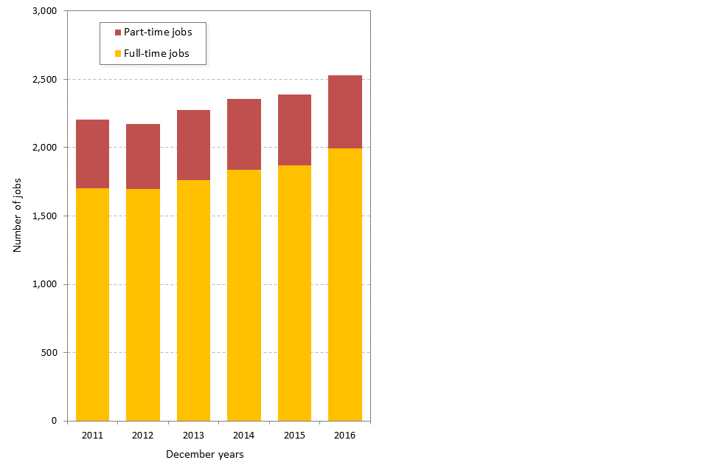
Job numbers have topped 2.5 million for the first time
The labour-force participation rate is almost 71% - the all time record & third highest in the OECD
JOBS

Slide 4
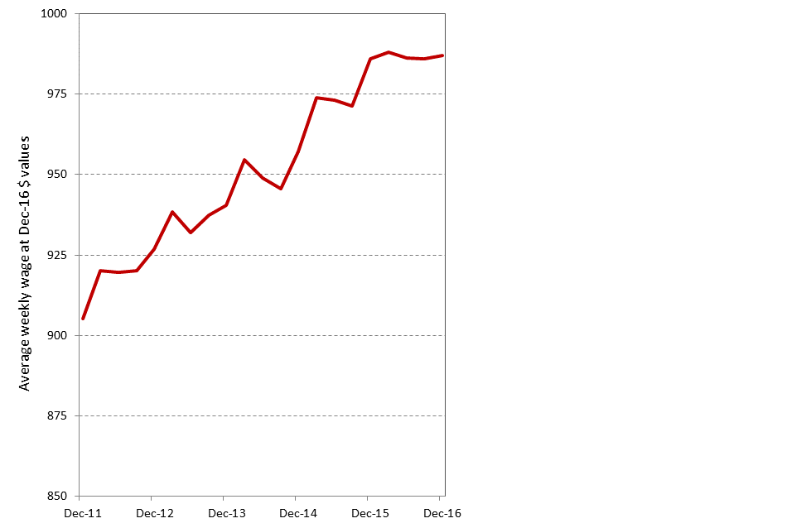
Average wages for employees have risen 9% in real terms in the past five years to $987 per week.
WAGES & SALARIES

Slide 5
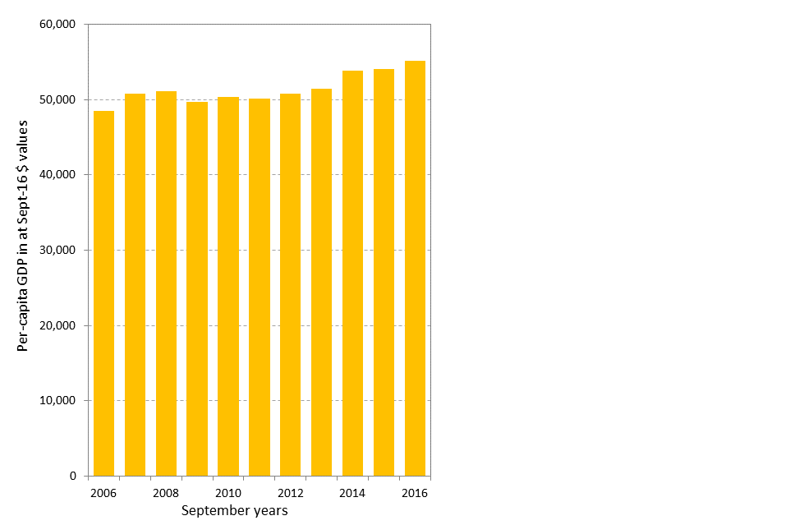
Per-capita GDP has grown by 10% in real terms over the past five years to $55,000
PER-CAPITA GDP

Slide 6
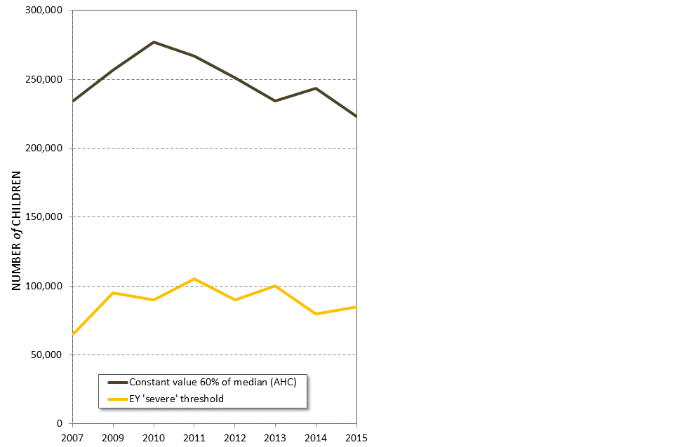
A number of measures for child poverty are available and for most there has been little or no decline in poverty rates over the past decade.
CHILD POVERTY

Slide 7
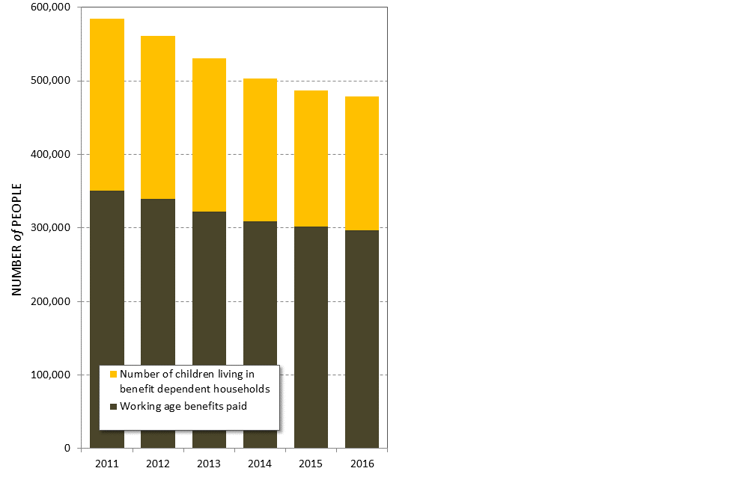
Over the past five years the number of working age adults receiving a benefit has declined by 54,000
The number of children living in benefit dependent households has fallen by 53,000 since late 2011
Despite claims that these people are better off no research has been done on what has happened to them.
BENEFIT NUMBERS

Slide 8
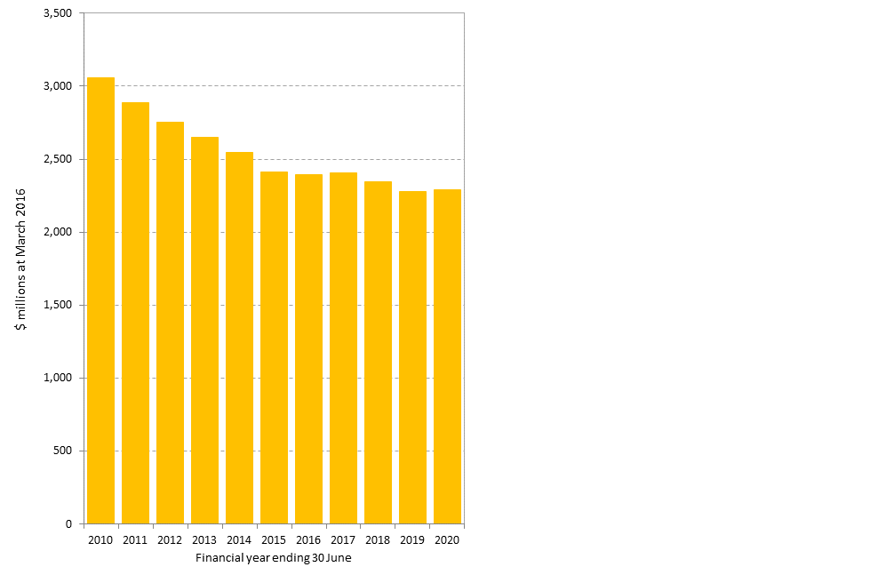
The real value of income support subsidies paid through the Working for Families programme has declined by $650 million to $2.4 billion annually in 2016/17
Further declines are of over $100 million forecast
WORKING FOR FAMILIES

Slide 9
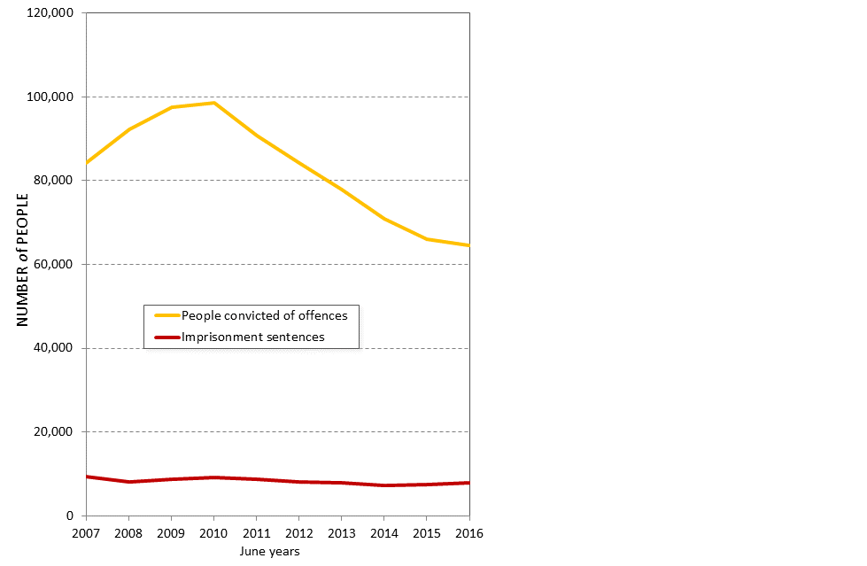
Despite the political rhetoric there is evidence that criminal offending is declining – the number of adults convicted of offences declined 29% over the past five years
Yet the numbers being sent to prison declined 10% and have begun to increase again
CONVICTIONS

Slide 10
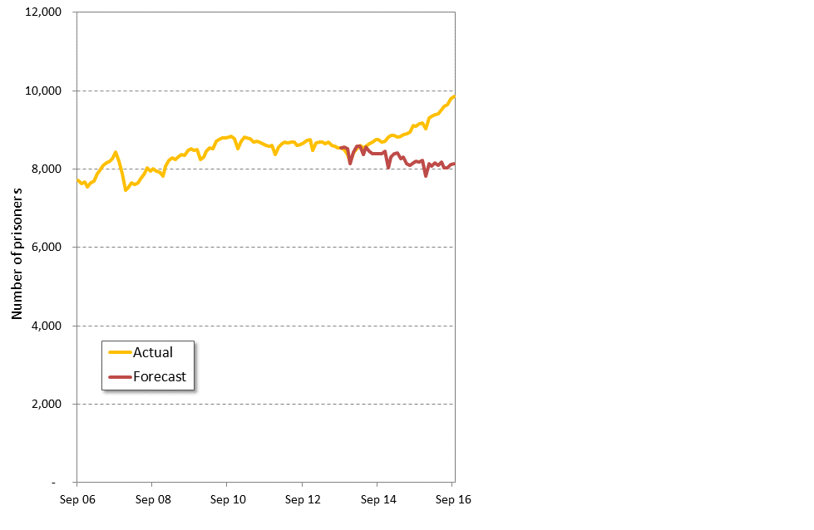
Prisoner numbers have reached new record levels and will most likely exceed 10,000 within three months
Yet less than three years ago Ministry of Justice were forecasting a present prisoner population of 8000
In September 2016 Government promised a further $1 billion to provide a further 1800 prison beds
PRISON POPULATION

Slide 11
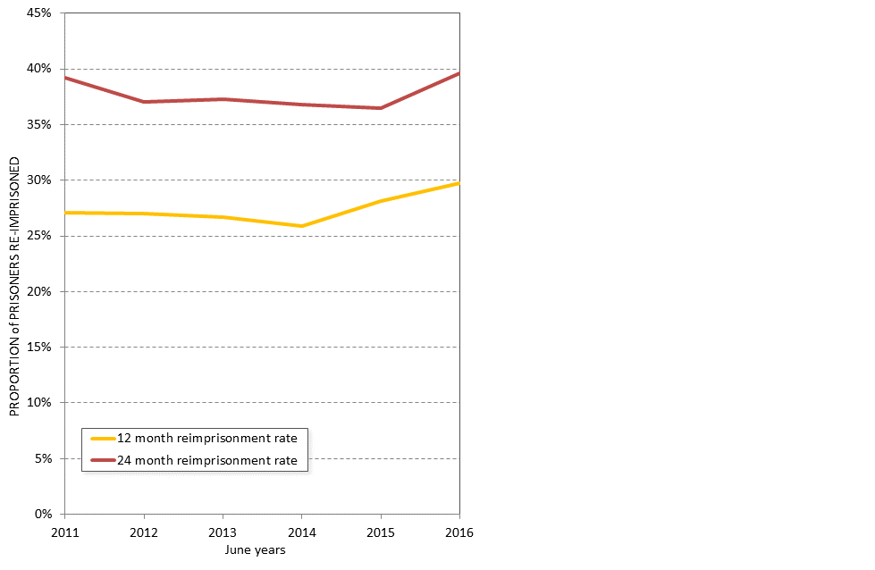
Re-conviction and re-imprisonment rates for released prisoners are as high as they have ever been
This is despite ambitious Better Public Services targets and record spending on prisoner rehabilitation and reintegration
RECIDIVISM

Slide 12
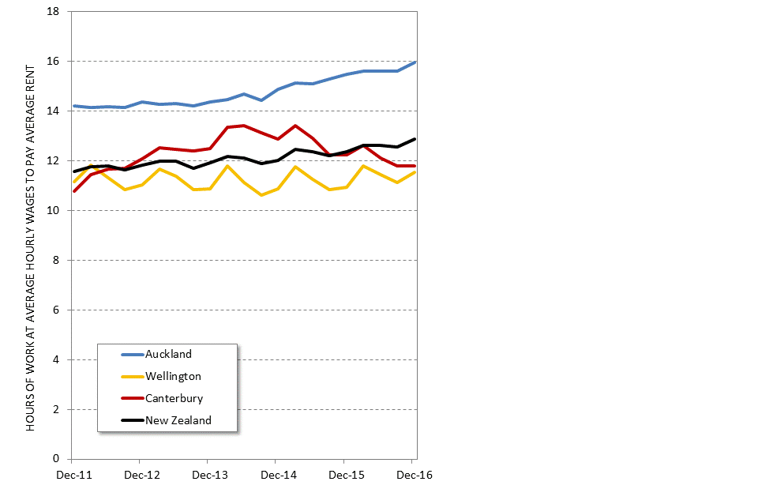
Over the past five years rents have tended to rise at twice the rate of wages and salaries
There are however wide regional variations with strongest recent increases in the northern North Island and recent declines in Canterbury
RENTS

Slide 13
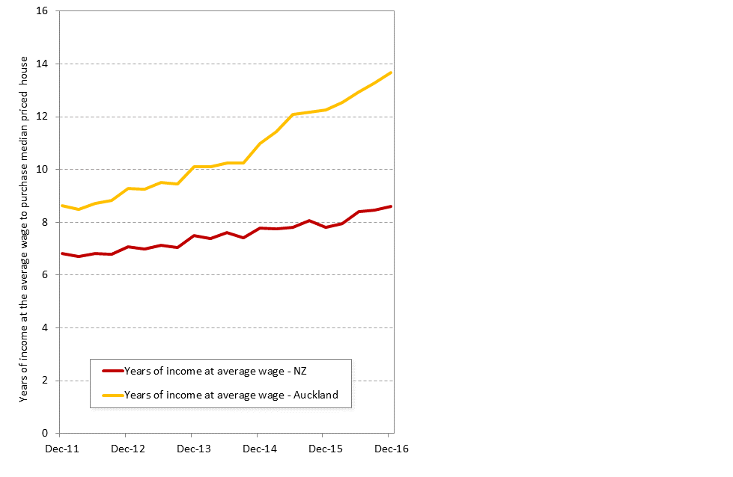
House prices relative to incomes have reached new levels of unaffordability
In Auckland is takes 13.7 years of the average wage to purchase a median price house – up from 12.1 two years ago
New Zealand wide prices are starting to rise against incomes – up 0.9 year to 7.8 years since 2014
HOUSE PRICES

Slide 14
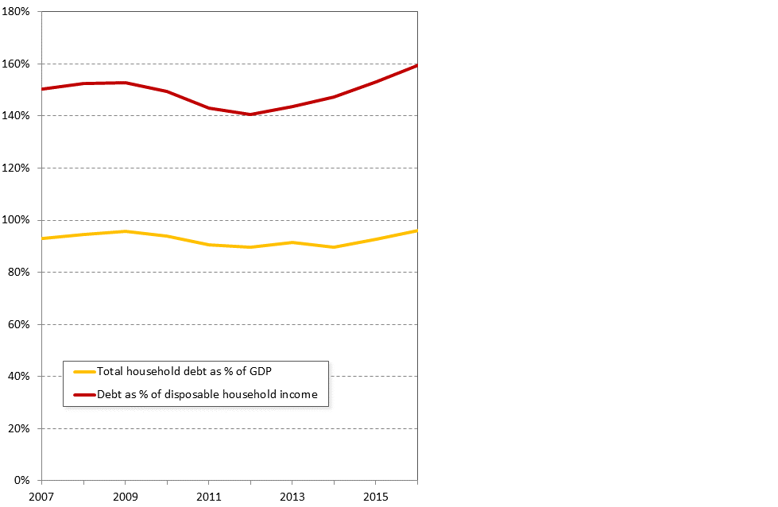
Household debt measures have reached new record highs although there is a wide variation across households in terms of their indebtedness
The good news is increased savings by wealthier households
The bad news is falling home-ownership rates
HOUSEHOLD DEBT

Slide 15
The Government’s growth agenda can probably be judged as being successful in its own terms – it has raised incomes for most working New Zealanders - it has increased the wealth of the wealthiest New Zealanders
Child poverty rates of between 8% and 22% of all children (however they are measured) have become the new normal for New Zealand - there are no identifiable policies attempting to change this
The prison population continues to rise as crime rates fall and recidivism rates remain intractable
Housing indicators push new records - which is good or bad news depending on which side of the ownership divide you are
SUMMARY

