Slide 1


The Cost of Living
Covenant Renewal Day 2014

Slide 2
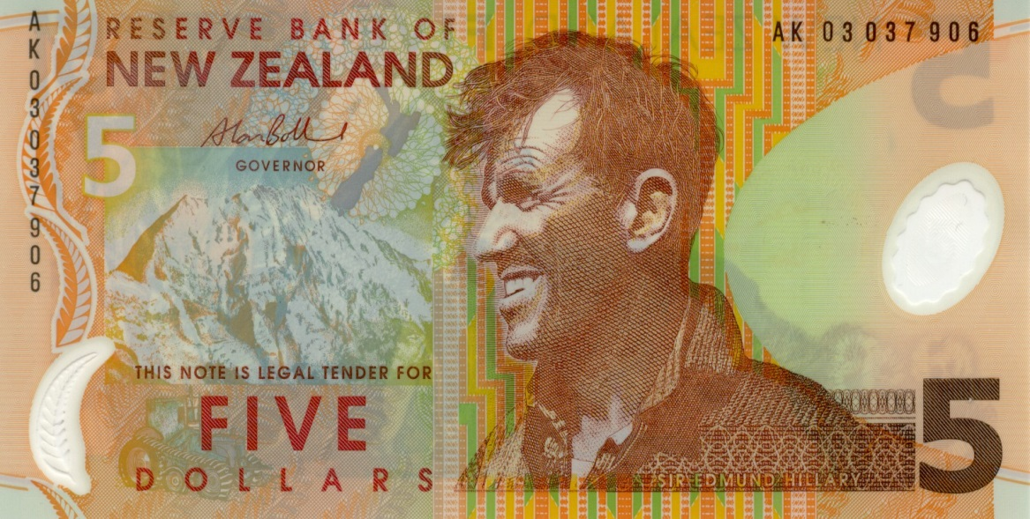
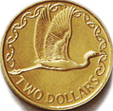
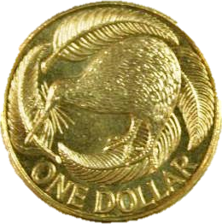

Slide 4
The Cost of Living
Covenant Renewal Day 2014

Slide 5
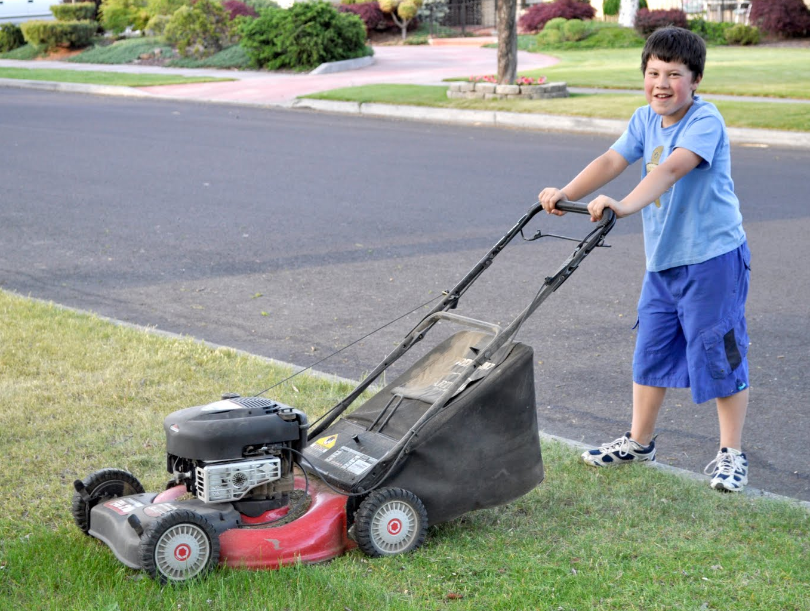

Slide 6
The Cost of Living
Covenant Renewal Day 2014

Slide 7
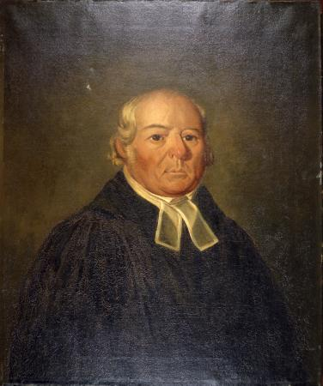
Samuel Marsden

Slide 8
The Cost of Living
Covenant Renewal Day 2014

Slide 9
Junior Soldier Promise
I know that Jesus is my Saviour from sin.
I have asked him to forgive my sins, and I will trust him to keep me good.
By his help, I will be his loving and obedient child, and will help others to follow him.
I promise to pray, to read my Bible, and to lead a life that is clean in thought, word and deed.
I will not use anything that may injure my body or my mind, including harmful drugs, alcohol and tobacco.

Slide 10
The Cost of Living
Covenant Renewal Day 2014

