Slide 1

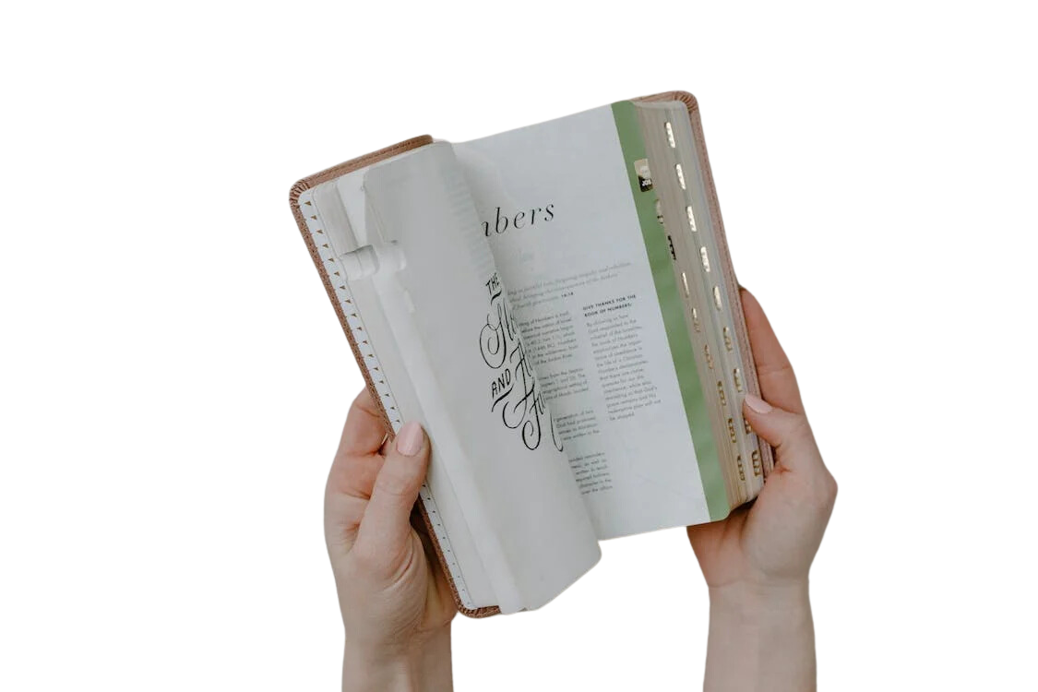







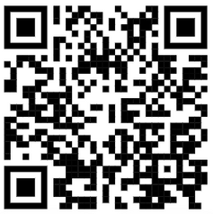

AN ACT OF KINDNESS
40 days. 40 acts.
The Salvation Army
International Spiritual Life Development
sar.my/spirituallife

Slide 2
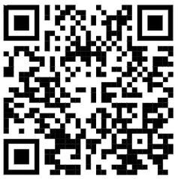
AN ACT OF KINDNESS
40 days. 40 acts.
The Salvation Army
International Spiritual Life Development
sar.my/spirituallife

